Slide 1
Energy systems
February 8, 2023

Slide 2




The energy system is at the heart of integrated assessment models…
Exogenous Assumptions
Outputs of IAMs
Population
Economy
Agriculture & Land Use
CO₂, GHGs, aerosols, OGs
Prices, Taxes, e.g. CO₂
Labor Productivity
Commodity Prices
Energy
Technology
Economic Activity
Primary Energy Supply
Policy
Electric & Refining
Crops & Forests
Resources
Livestock
Water
Climate
Temperature, RF
External Data
2

Slide 3
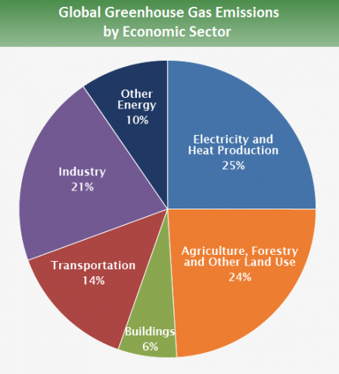
...because the energy system is at the heart of the climate problem…
Source: https://www.epa.gov/ghgemissions/global-greenhouse-gas-emissions-data

Slide 4
Three main components of the energy system
Primary Energy
Secondary Energy
Final Energy
Resources
(e.g. coal, gas, oil)
Conversion
(e.g. electricity)
Services
(e.g. heating, cooling)
Energy Supply
Energy Demand

Slide 5
Components of and processes in the energy system: Some details
Source: GEA, 2012

Slide 6
Components of and processes in the energy system: Example starting with a fossil resource
Source: GEA, 2012

Slide 7
Components of and processes in the energy system: Example starting with a ren resource
Source: GEA, 2012

Slide 8
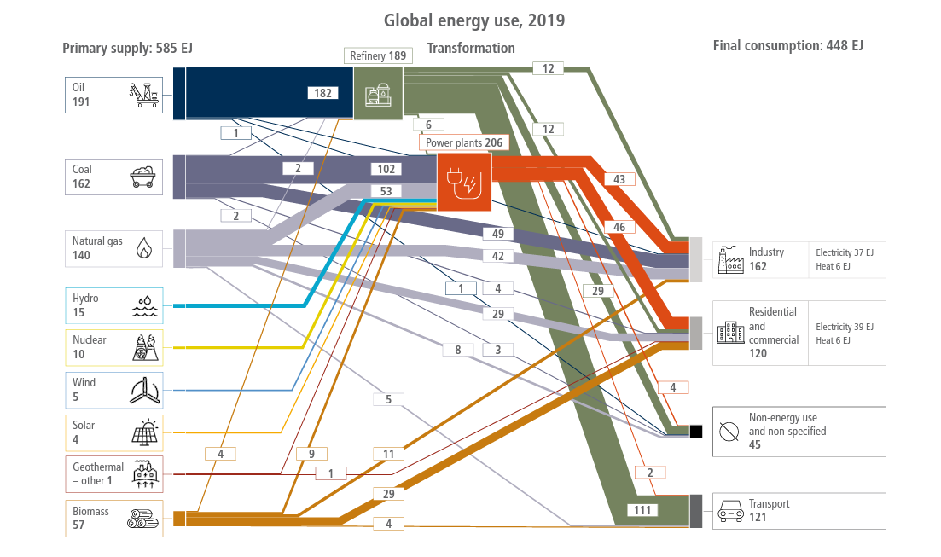
Global flow of energy in 2019
Source: IPCC, AR6

Slide 9
Quick refresher #2: International climate policy

Slide 10

How much do we need to reduce global GHG emissions to implement the Paris goal?
The international community has established ambitious long-term goals
Holding the increase in the global average temperature to well below 2 °C above pre-industrial levels and to pursue efforts to limit the temperature increase to 1.5 °C above pre-industrial levels

Slide 11
100%

Slide 12
How much should energy-system emissions be reduced?

Slide 13
100%+

Slide 14
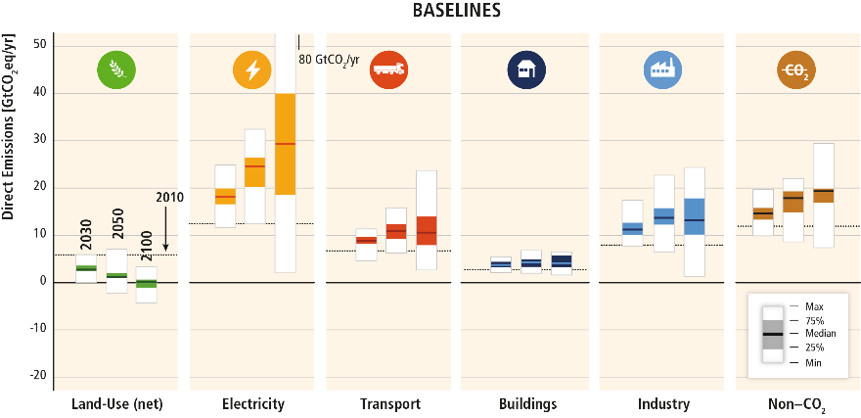
Scenarios produced by IAMs suggest emission increases in the absence of focused policies
GHG emissions in “No climate Policy” scenarios
Source: IPCC, AR5

Slide 15
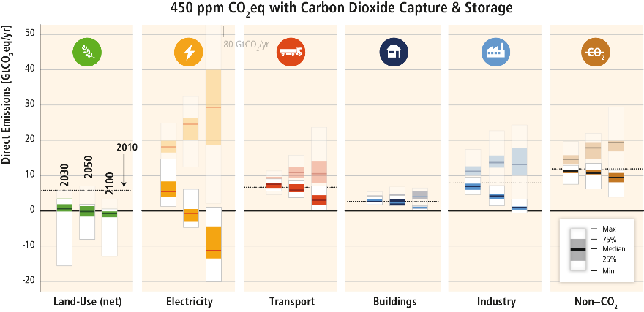
Scenarios based on IAMs that incorporate Paris goals are characterized by major emissions reductions in the energy system
GHG emissions in mitigation scenarios (dark) compared to emissions in baseline scenarios (light)
Source: IPCC, AR5

Slide 16
Quick refresher #3: Energy technologies

Slide 17
What kinds of energy technologies result in non-zero emissions?

Slide 18
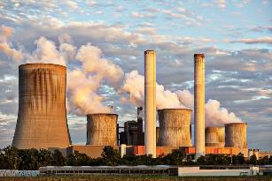
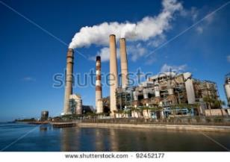


What kinds of energy technologies result in non-zero emissions?
Coal-fired power plants
Oil refineries, industries
Combustion engines
Building furnaces

Slide 19
What kinds of energy technologies result in low- or zero- emissions?

Slide 20
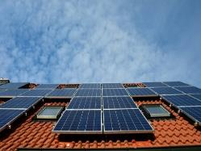
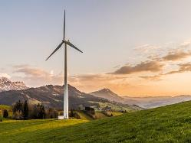
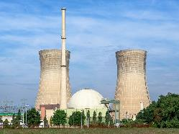
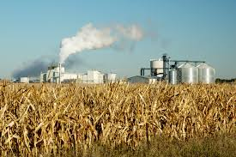

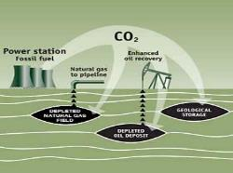
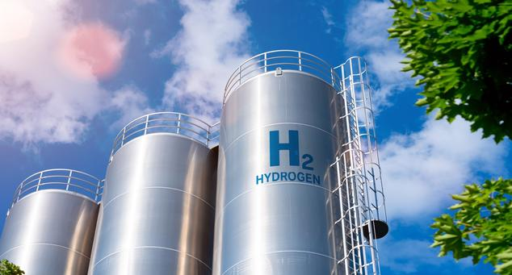
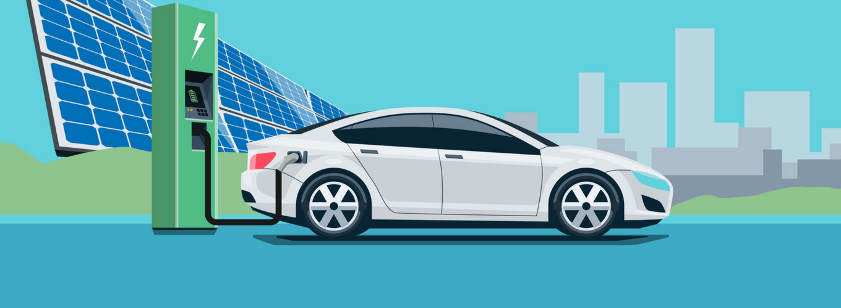
What kinds of energy technologies result in low- or zero- emissions?
Renewables
Nuclear
Biofuels
Carbon Capture Utilization & Storage
Hydrogen
Electric vehicles

Slide 21
What kinds of energy technologies result in negative emissions?

Slide 22
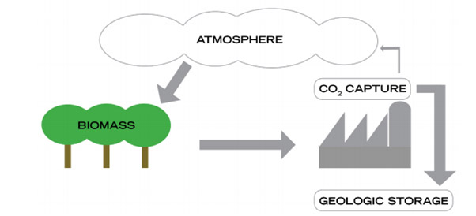
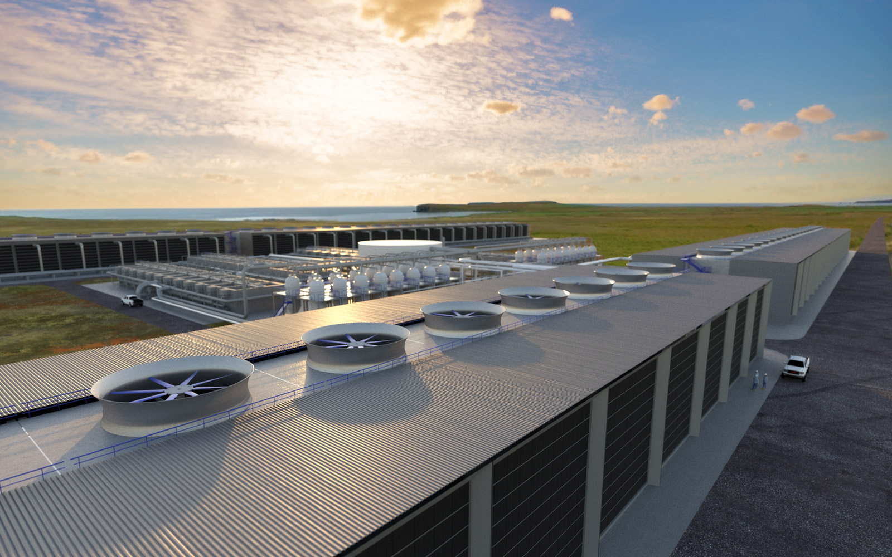
What kinds of energy technologies result in negative emissions?
Bioenergy + CCUS
Direct Air Capture
https://www.globalccsinstitute.com/insights/authors/AliceGibson/2015/11/25/importance-bio-ccs-deliver-negative-emissions

Slide 23
Key questions of interest in the energy-climate problem that we will focus on today
What kinds of transitions need to occur in the energy system to achieve deep emissions reductions? What is the role of different energy technologies in these transitions?
What is the role of institutions in those transitions?

Slide 24
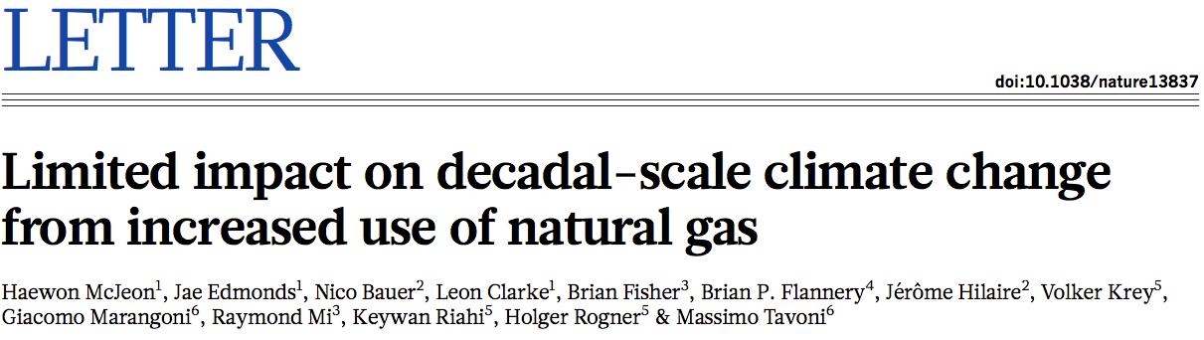
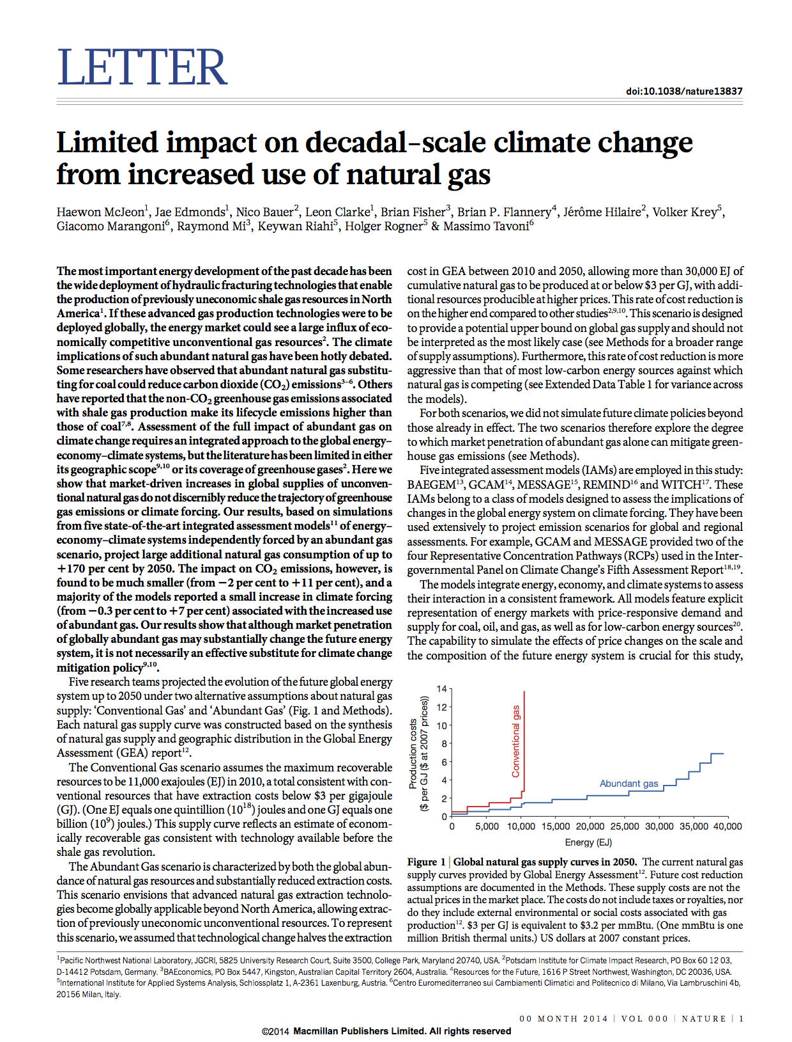
Abundant Gas Project:
Can abundant natural gas on its own substantially mitigate climate change in the absence of climate policies?

Slide 25
Two sides of the argument
“... natural gas – if extracted safely, it’s the bridge fuel that can power our economy with less of the carbon pollution that causes climate change.”
“In broad terms, we find that, given the large amounts of natural gas available in the U.S. at moderate cost … natural gas can indeed play an important role over the next couple of decades (together with demand management) in economically advancing a clean energy system.”
“Thanks to an increased use of affordable domestic natural gas, US power sector greenhouse gas emissions are at the lowest levels in 20 year.”
“Over a 20-year time period, the greenhouse-gas footprint of shale gas is worse than that for coal or oil”
"Shale gas is a great advantage to the U.S. in the short term, for the next few decades, but it is so attractive that it threatens other energy sources we ultimately will need."
“Cutting greenhouse gas emissions by burning natural gas is like dieting by eating reduced-fat cookies. It may be better than eating full-fat cookies, but if you really want to lose weight, you probably need to avoid cookies altogether.”

Slide 26
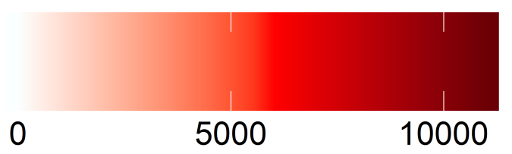
Global Natural Gas Resource Estimates
Natural Gas Resource (EJ)

Slide 27
Natural Gas Supply Curves

Slide 28
Model results

Slide 29
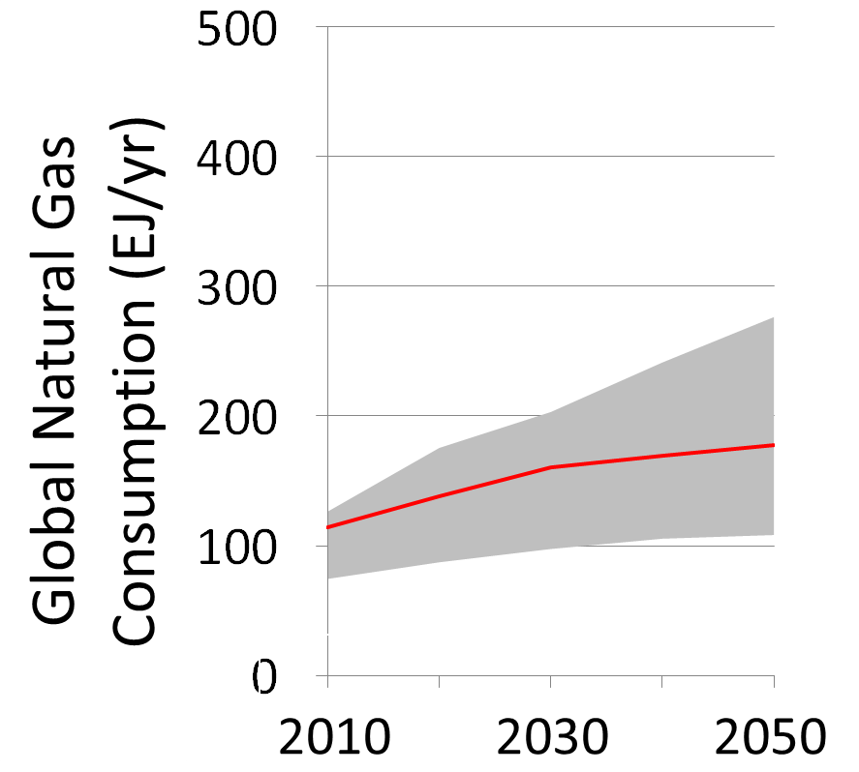
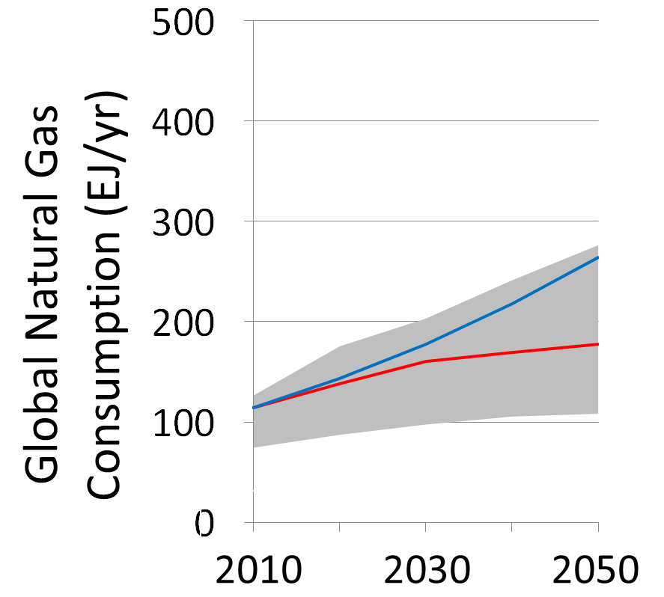
Natural Gas Consumption

Slide 30
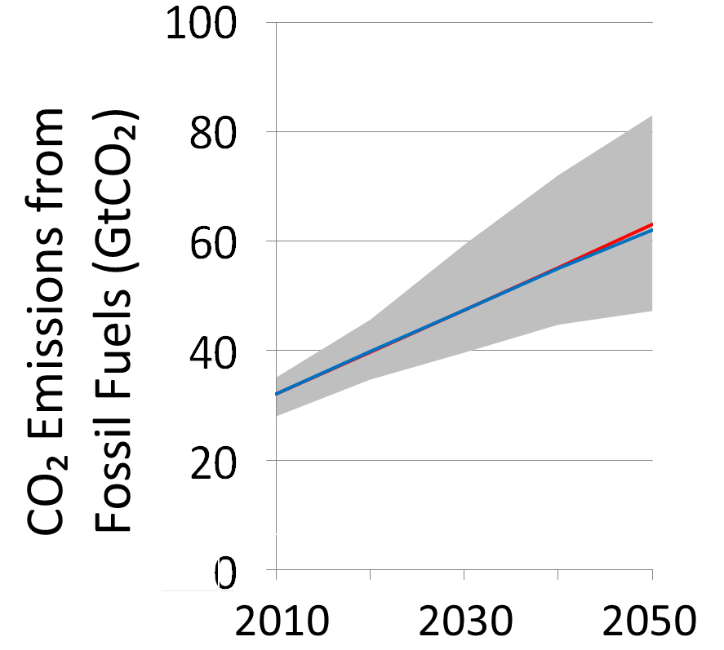
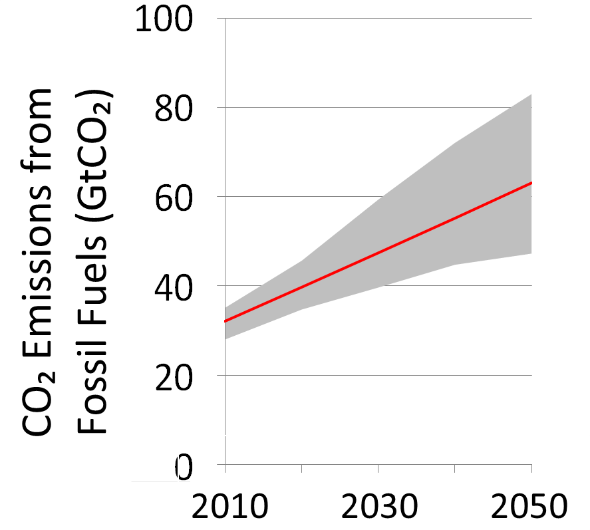
CO₂ Emissions

Slide 31
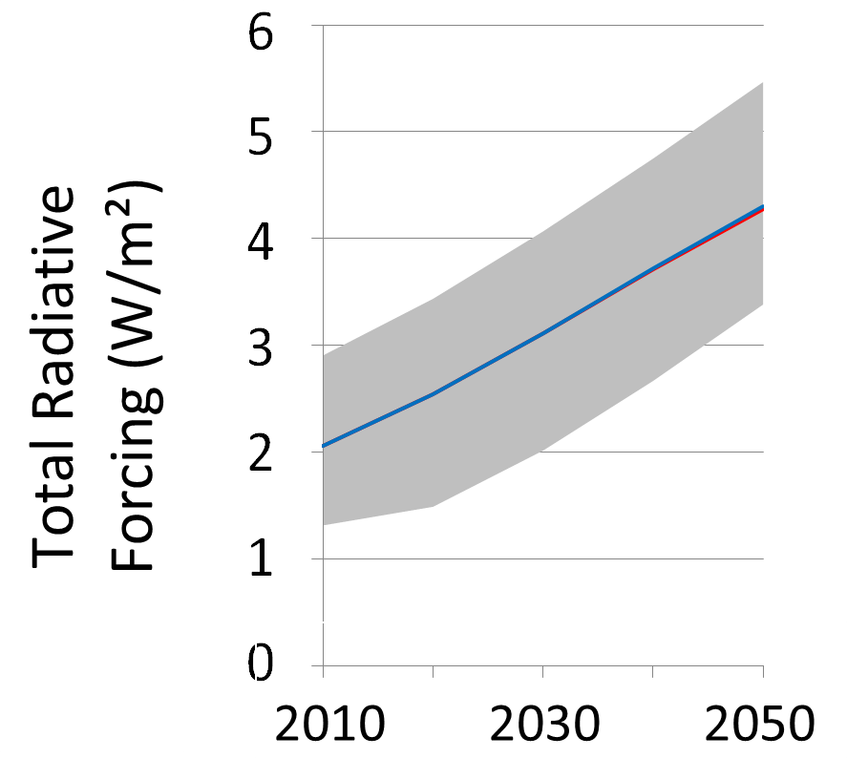
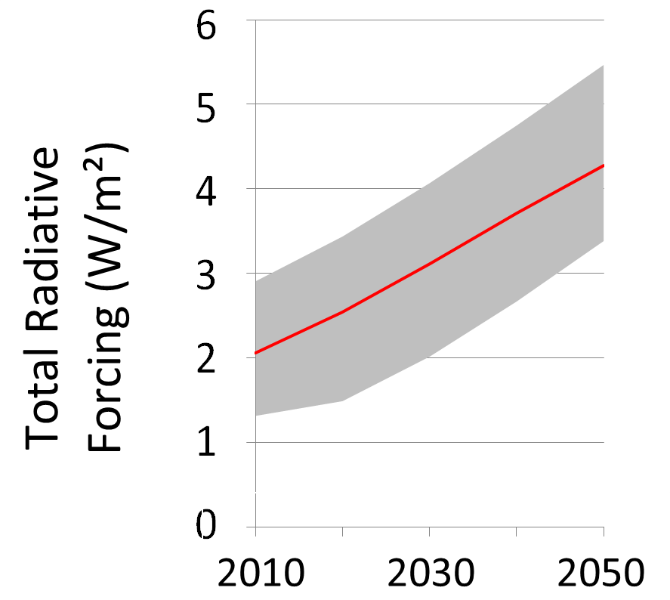
Radiative Forcing

Slide 32
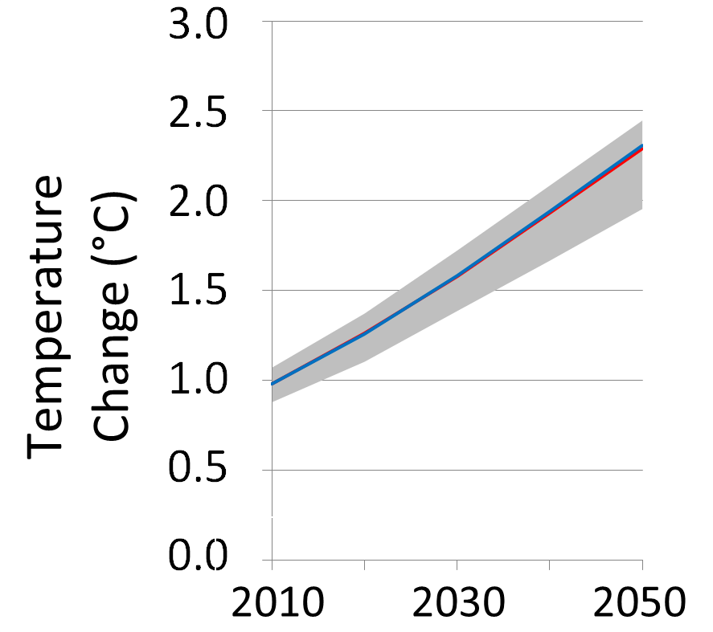
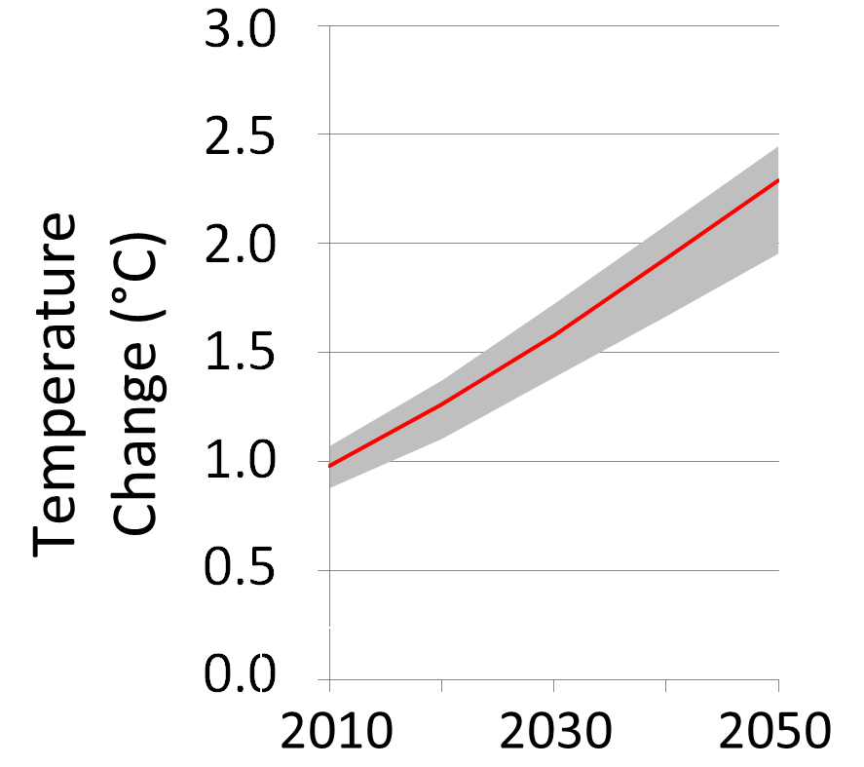
Temperature Change

Slide 34
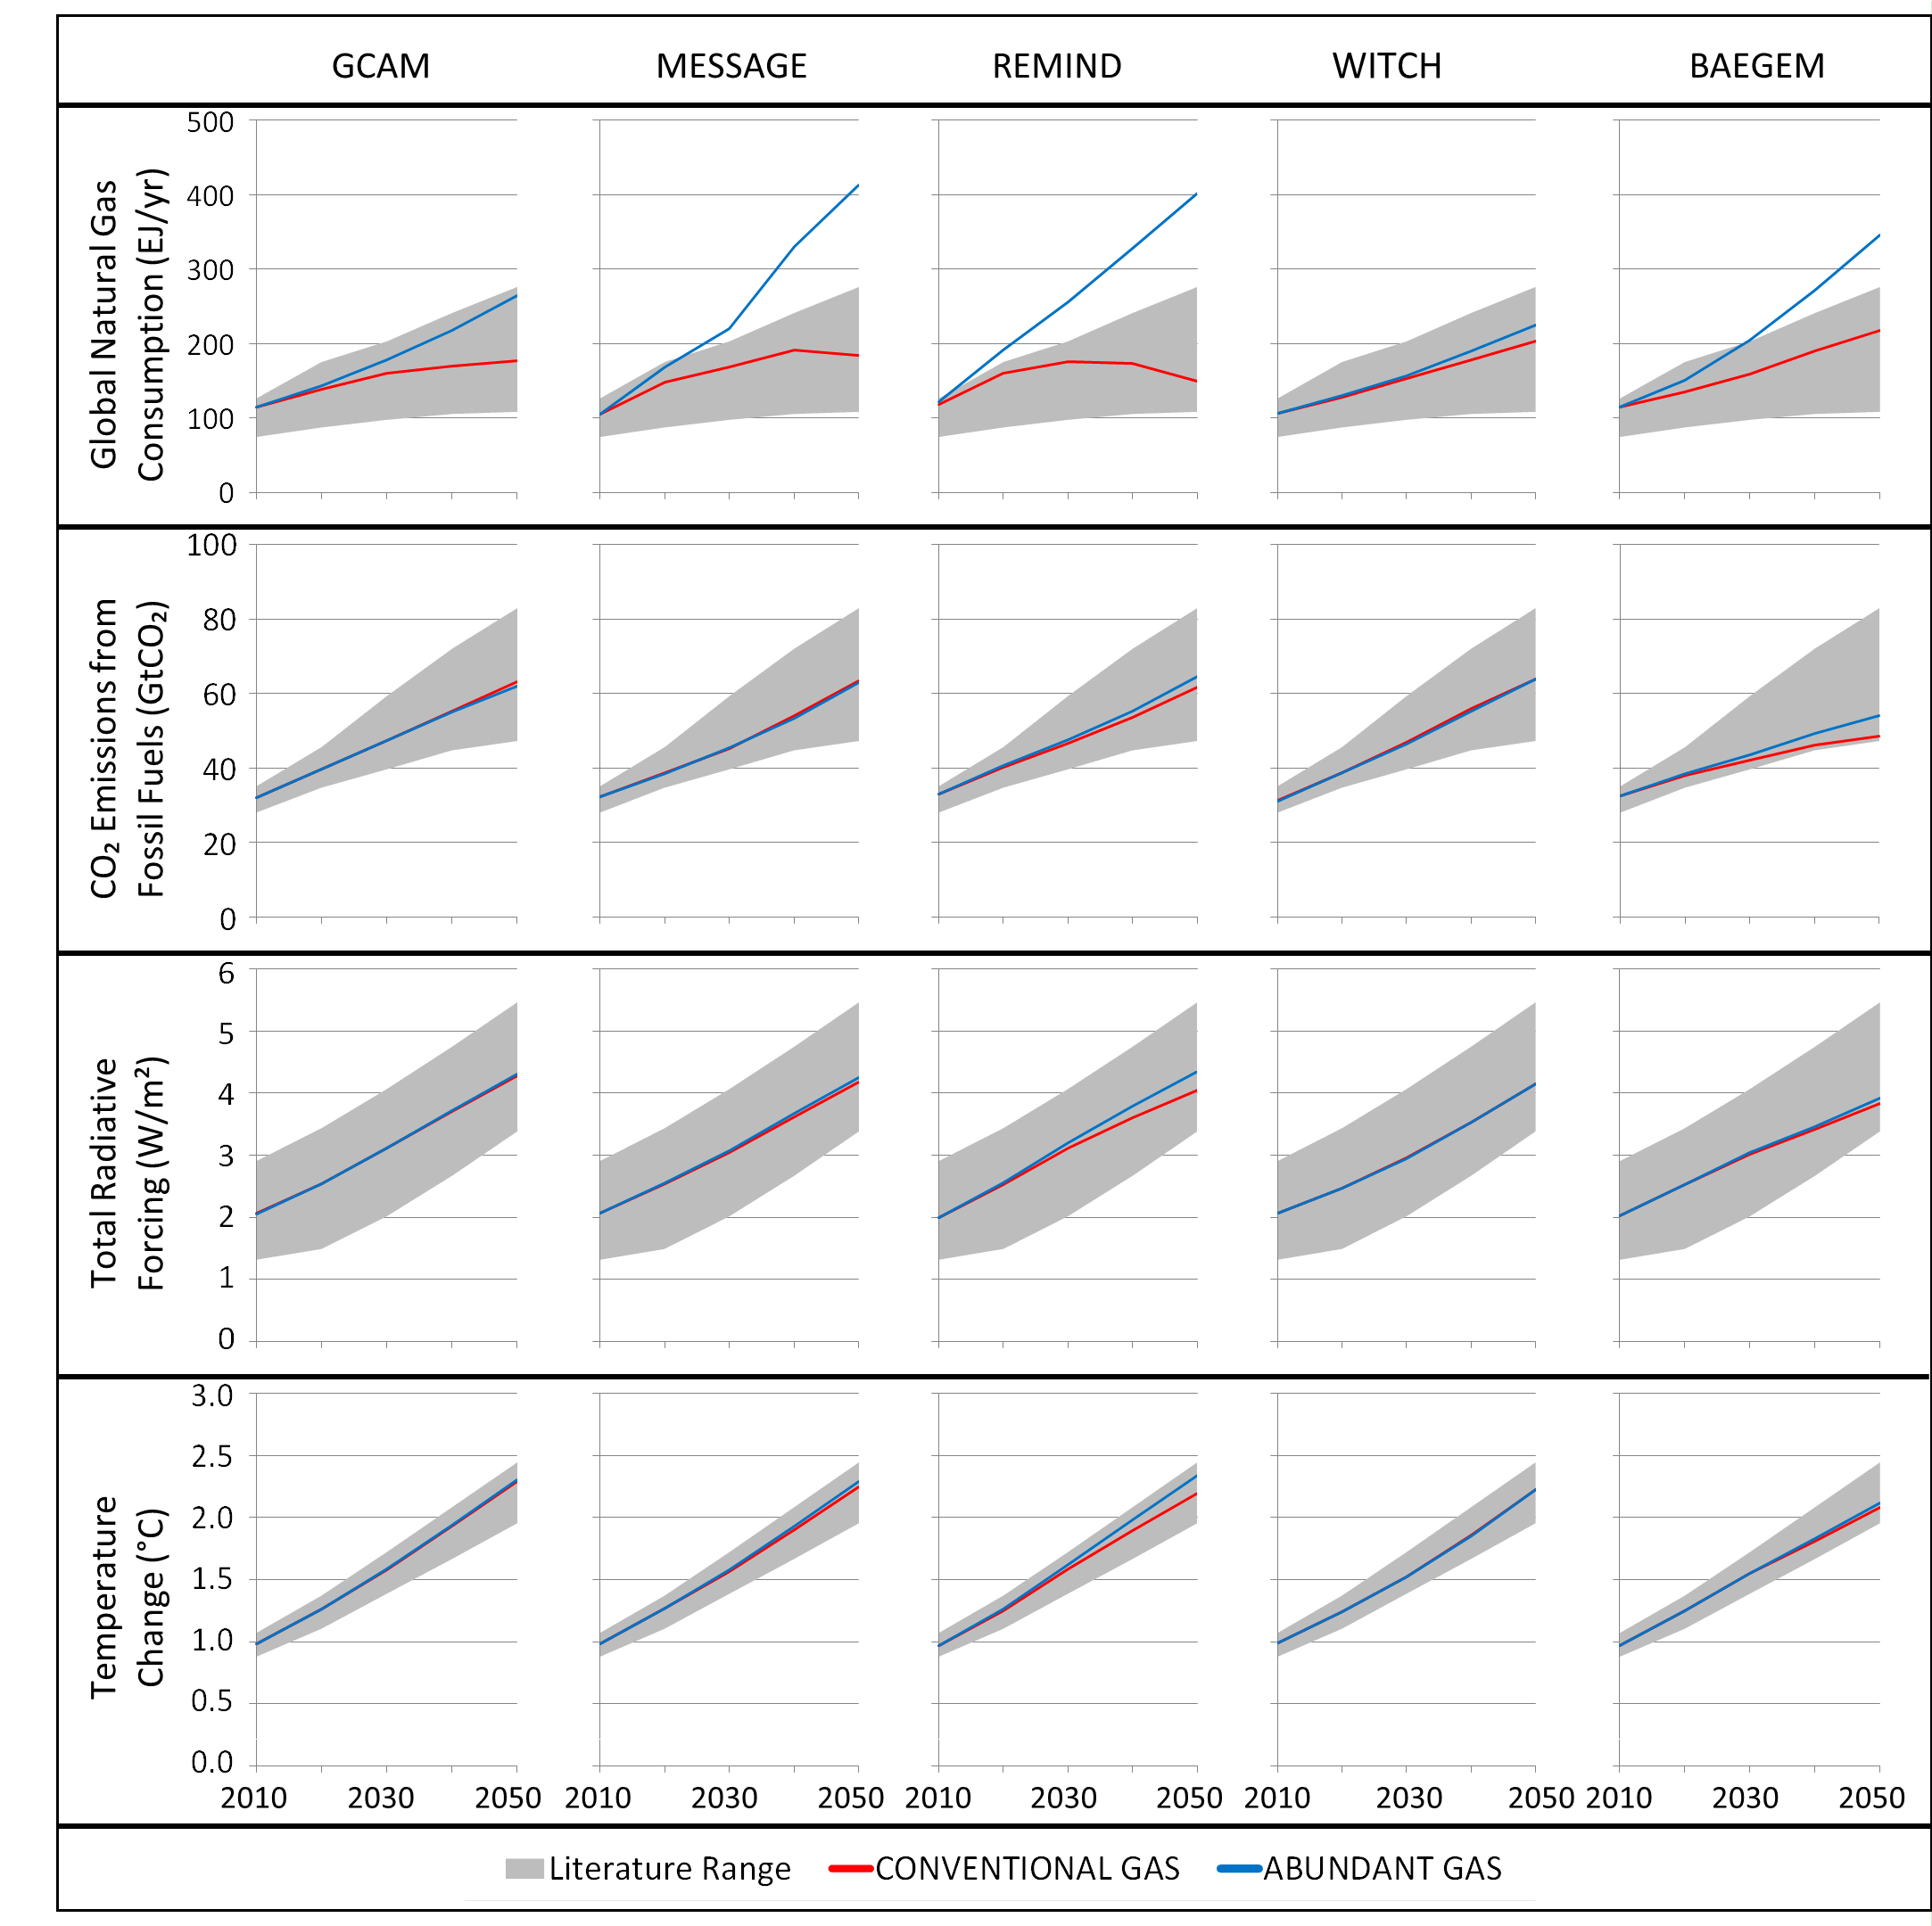

Slide 36
But why?

Slide 37
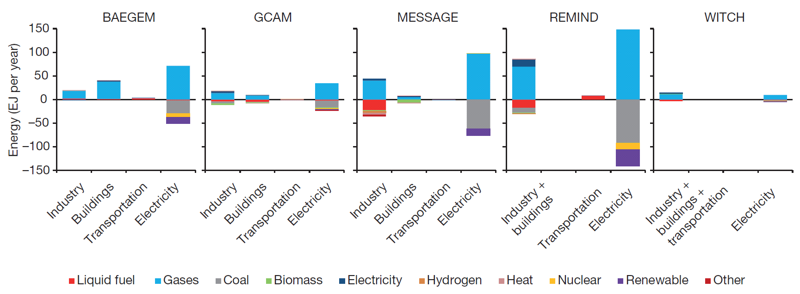
Energy Consumption Difference 2050

Slide 38
Radiative Forcing in 2050

Slide 40
Abundant Gas Project:
Can abundant natural gas on its own substantially mitigate climate change in the absence of climate policies?

Slide 41
Emission reductions in Energy scenarios

Slide 42
Example using GCAM: Six Emissions Scenarios
Three assumptions about emissions in 2050 (Energy system CO₂ only)
Decline slightly from 2020 to 2010 levels by 2050
Decline to 25% below 2010 levels in 2050
Decline to 50% below 2010 levels in 2050 (2⁰C Scenario)
Three technology assumptions
Full technology
No BioCCS
No CCS and Nuclear
Assumptions are consistent with literature

Slide 43
Primary Energy: Reference Scenario
Full Technology Portfolio
No Bio CCS
No Nuclear and CCS

Slide 44
Primary Energy: 2010 Emissions
Full Technology Portfolio
No Bio CCS
No Nuclear and CCS

Slide 45
Primary Energy: 25% reduction
Full Technology Portfolio
No Bio CCS
No Nuclear and CCS

Slide 46
Primary Energy: 50% reduction
Full Technology Portfolio
No Bio CCS
No Nuclear and CCS

Slide 47
Electricity production: Reference Scenario
Full Technology Portfolio
No Bio CCS
No Nuclear and CCS

Slide 48
Electricity production: 2010 Emissions
Full Technology Portfolio
No Bio CCS
No Nuclear and CCS

Slide 49
Electricity production: 25% reduction
Full Technology Portfolio
No Bio CCS
No Nuclear and CCS

Slide 50
Electricity production: 50% reduction
Full Technology Portfolio
No Bio CCS
No Nuclear and CCS

Slide 51
Onshore wind energy capacity in the 50% Scenarios
Much more to get to net-zero
Almost 9000 GWe installed capacity by 2050
2000 GWe installed capacity by 2030
Almost 3700 GWe installed capacity by 2050
About 837 GWe installed capacity in 2022 (actual)
Note: Assumes a 25% average future global onshore wind capacity factor

Slide 52
Number of wind turbines in 50% reduction scenarios
Many more to get to net-zero
Around 1.4 million additional 5 MW turbines from 2030 through 2050
330,000 additional 5 MW turbines from 2017 through 2030
600,000 additional 5 MW turbines from 2017 through 2050
341k turbines in 2017 (actual)
Note: Assumes a 25% average future global onshore wind capacity factor

Slide 53
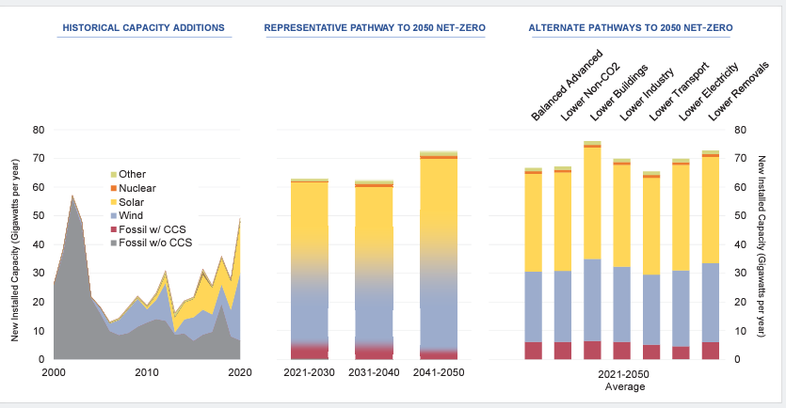
IAM based pathways toward net-zero emissions in the U.S. by 2050 suggest significant scaling up of investments compared to historical rates
U.S. Electric Generation Capacity Additions
Source:
U.S. LTS 2021

Slide 54

Scenarios consistent with Paris goals are characterized by stranded assets
Mitigation could result in pre-mature write-downs, devaluations, and conversion to liabilities of carbon-intensive assets, referred to as “stranding” of assets.
https://www.greenbiz.com/article/state-green-business-stranded-assets
In the context of climate change mitigation, stranded assets could manifest in various forms such as:
Fossil-fuel resources that cannot be burned in order to maintain a long-term temperature goal
Pre-mature retirement of carbon-intensive capital due to climate policies

Slide 55

Why are stranded assets important?
Stranded assets could create financial and political threats:
Economic risks: Financial risks that could arise for parties that have suffered loss and damage from climate change mitigation.
Political economy risks: Stranded assets create loss of wealth for few and could result in lobbying and rent-seeking behavior.
https://www.reminetwork.com/articles/climate-risk-raises-stranded-asset-potential/

Slide 56
Globally, investments and stranded assets implications of Paris Agreement are non-trivial
Capacity Additions and pre-mature retirements [GW/yr]
Paris to 2°C
No Paris to 2°C
Least Cost 2°C
Current installed capacity globally is ~8000GW.
The Paris- and No Paris to 2°C scenarios suggest
pre-maturely retiring 20-25% of this capacity beyond 2030
Source: Iyer et al., 2015, The contribution of Paris to limit global warming to 2°C, Environmental Research Letters

Slide 57
Globally, investments and stranded assets implications of Paris Agreement are non-trivial
Capacity Additions and pre-mature retirements [GW/yr]
Paris to 2°C
No Paris to 2°C
Least Cost 2°C
Stranded asset implications under 1.5°C would be even more prominent
Source: Iyer et al., 2015, The contribution of Paris to limit global warming to 2°C, Environmental Research Letters

Slide 58
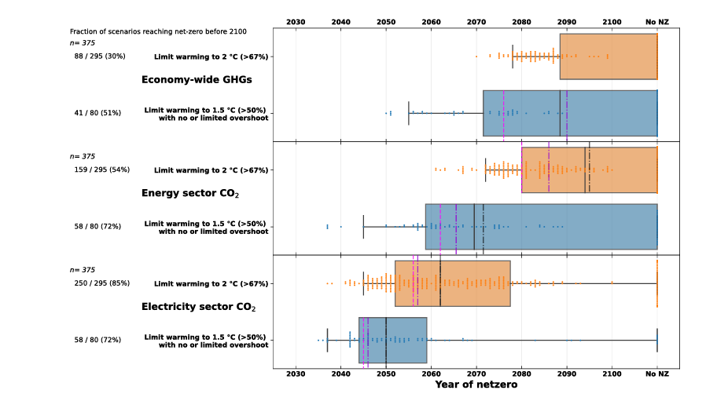
The timing of net-zero varies by sector
Black vertical line is the median across many IAM scenarios
Note that the range across scenarios is quite wide
Source: IPCC, AR6
Boxes indicate 25th and 75th percentiles, center black line is the median, while whiskers indicate 1.5x the inter-quartile range. The vertical dashed lines represent the median point at which emissions in the scenarios have dropped by 95% (pink) and 97.5% (purple), respectively. Dots represent individual scenarios. The fraction indicates the number of scenarios reaching net-zero by 2100 out of the total sample. Source: AR6 Scenario Database.

Slide 59
Mitigation scenarios are characterized by a major upscaling of low- and zero- carbon energy
Total Low-Carbon Energy Supply
Scenarios that are consistent with 2°C warming by the end of the century
Scenarios that are consistent with 3°C warming by the end of the century
No Policy Scenarios that are consistent with >4°C warming by the end of the century
Source: IPCC, AR5

Slide 60
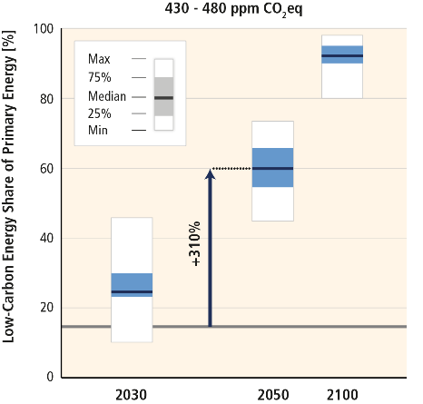
Mitigation scenarios consistent with 2°C warming are characterized by a tripling to nearly a quadrupling of the share of zero- and low-carbon energy supply
Scenarios that are consistent with 2°C warming by the end of the century
2010
Source: IPCC, AR5

Slide 61
Questions

Slide 62
What is the role of institutions in such transitions?

Slide 63
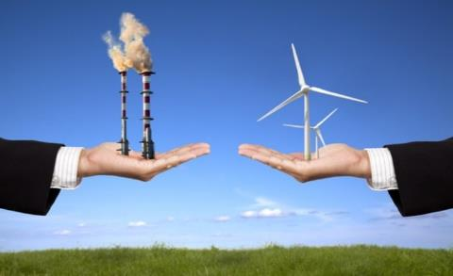
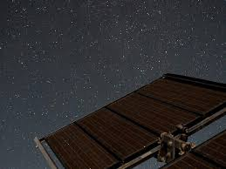
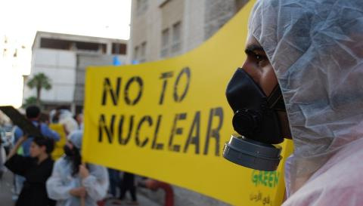
Many non-economic factors could affect the rate at which technologies deploy
Institutions
Policy/regulatory uncertainty
Public perceptions

Slide 64
Institutional capacities are non-uniform across the globe
Source: World Economic Forum Global Competitiveness Survey

Slide 65
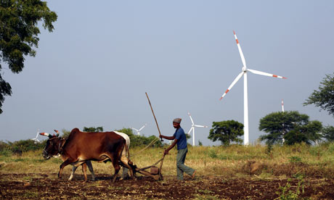
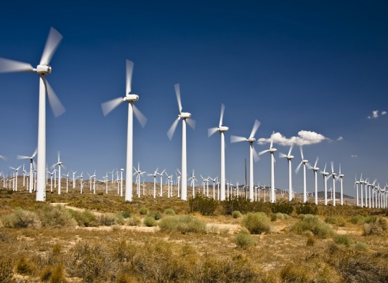
Institutional factors can affect investors’ perceptions of risks
AFRICAN WIND FARM
Cost of debt ~ 12-13%
U.S. WIND FARM
Cost of debt ~ 8-9%

Slide 66
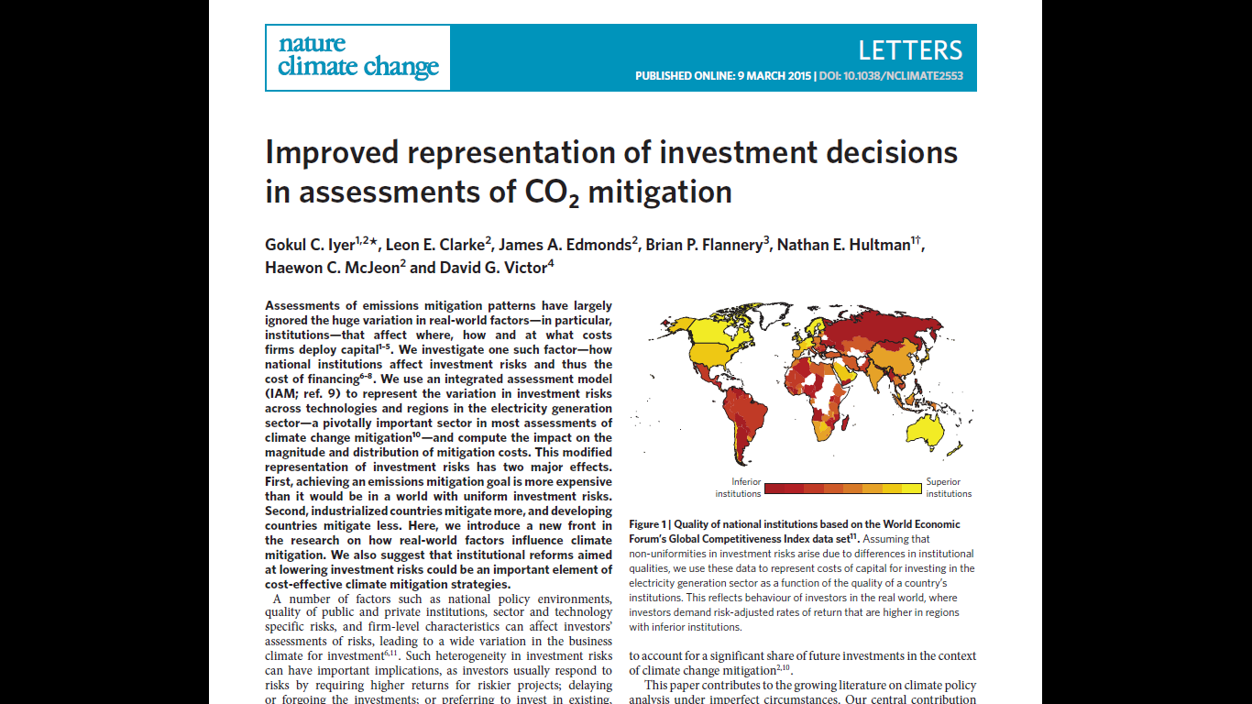
Implications of nonuniform investment risks
Nonuniform investment risks can have important implications as investors respond to risks by
Expecting higher returns for riskier projects
Delaying or forgoing investments
Preferring to invest in existing, familiar technologies
How could heterogeneity in investment risks influence cost and distribution of climate change mitigation?

Slide 67
Incorporating risk perceptions in GCAM resulted in three effects
Investments in electricity for 50% reduction in CO2 emissions by 2050
(Billion 2012 USD per year)
Reduced investments in high risk low-carbon technologies (e.g. nuclear) and increased investments in BECCS and energy efficiency
Shift of investments from developing to developed world
Higher costs for meeting a given emissions goal
About 40% higher carbon price for a 50% reduction in CO2 emissions by 2050
Changes relative to uniform investment risks

Slide 68
Key Insights from the study
Major efforts to improve the institutional environment need to be essential elements of a larger strategy for reducing emissions cost-effectively
It is plausible that institutional reforms may even be more important than technology-focused policies.
Absent such reforms, mitigation effort could be disproportionately focused on countries where investment risks are lower.

Slide 69
Some emerging areas of energy systems research in IAMs
Stranded assets under climate mitigation
Effect of trade and geopolitical relationships on energy system transitions
Linkages with mineral supply chains: Implications of mineral supply chains for energy system transitions and vice versa
Linkages with sustainable development goals
Spatial and sub-annual details to better capture intra-annual dynamics (e.g. storage in the power sector)
Impacts of changing intra-annual load patterns driven by climate, electric vehicle charging, etc.
Impacts of behavioral changes

Slide 70
What kinds of transitions need to occur in the energy system to achieve deep emissions reductions?
What is the role of different energy technologies in these transitions?

Slide 71
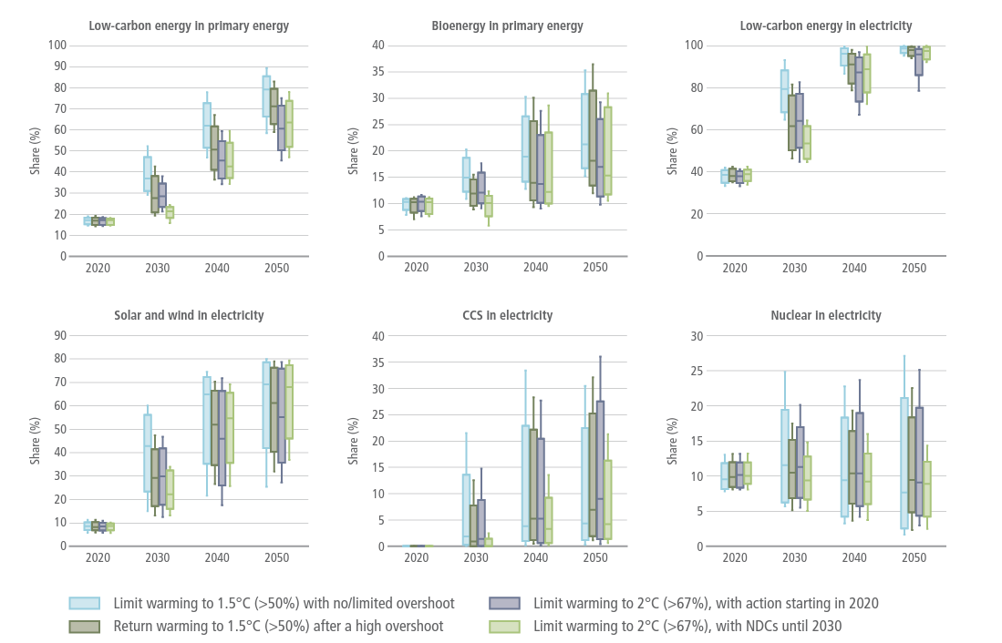
Scenarios consistent with Paris goals are characterized by major scaling up of low carbon technologies
Boxes indicate 25th and 75th percentiles;
whiskers indicate 5th and 95th percentiles
Source: IPCC, AR6

Slide 72
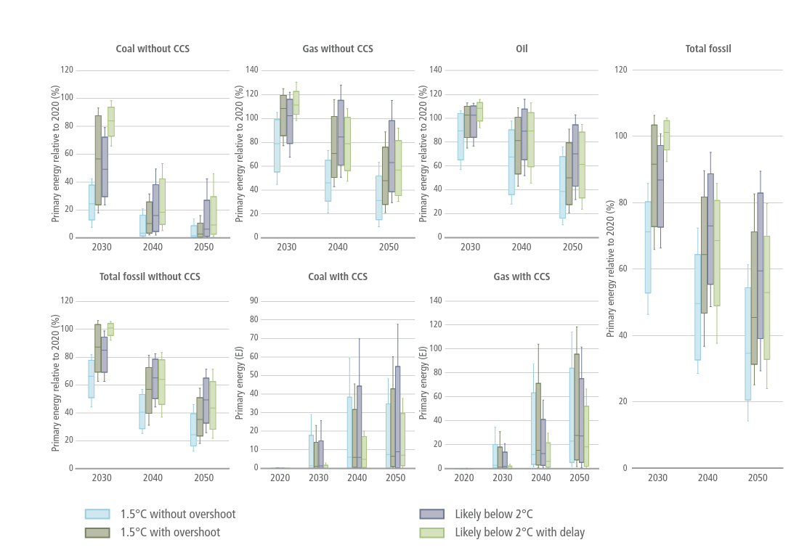
Scenarios consistent with Paris goals are characterized by decreases in fossil production and consumption
Boxes indicate 25th and 75th percentiles;
whiskers indicate 5th and 95th percentiles
Source: IPCC, AR6

Slide 73
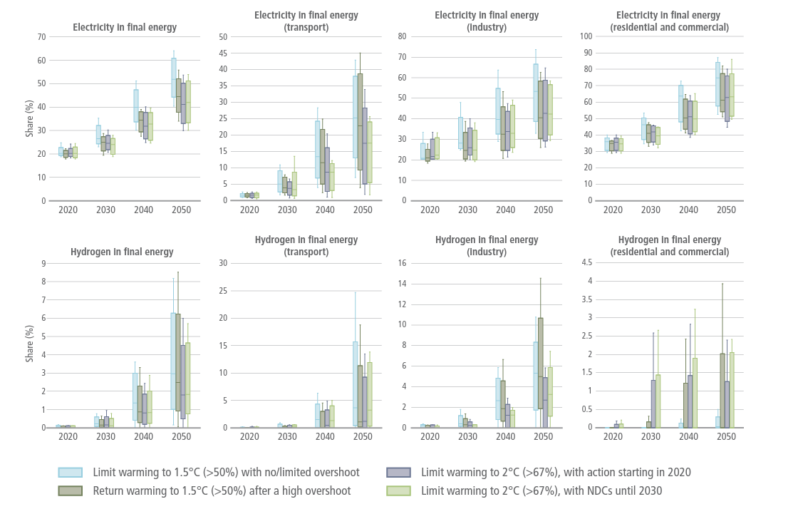
Scenarios consistent with Paris goals are characterized by increases in electricity and H2 in end-use sectors
Boxes indicate 25th and 75th percentiles;
whiskers indicate 5th and 95th percentiles
Source: IPCC, AR6

Slide 74
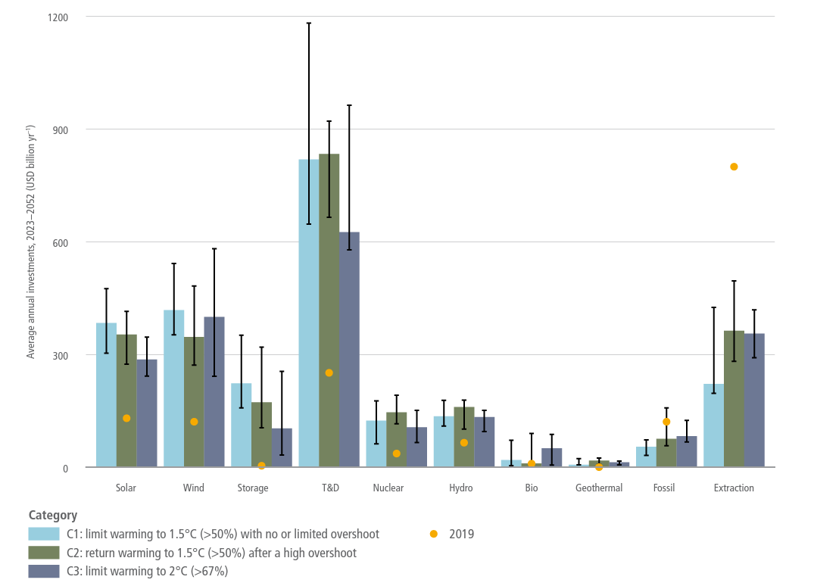
Scenarios consistent with Paris goals are characterized by changes in investment patterns
Global average annual investments (2023–2052) [Billion USD/ yr]
Bars show median values across models-scenarios, and whiskers the interquartile ranges
Source: IPCC, AR6

